Slide 1
Digital Concept and Overview
Part1
Course : CPEN6265010 Digital System
Effective Period : September 2025

Slide 2
Related LO
Learning Objectives
LO1: Analyze and Design Combinational Logic Circuits.

Slide 3
Outlines
Digital and Analog Quantities
Binary Digits, Logic Levels, and Digital Waveforms
Basic Logic Functions

Slide 4
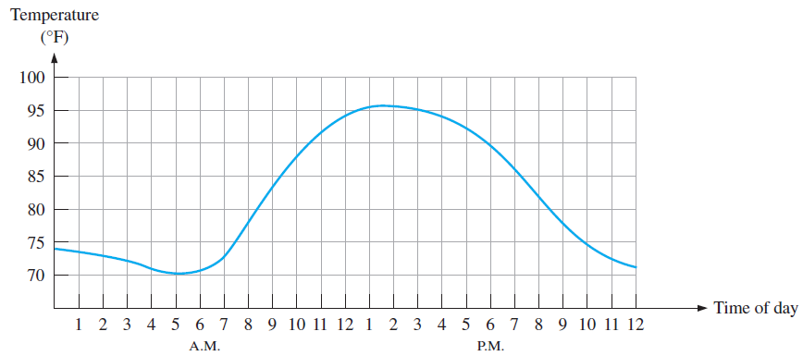
Digital and Analog Quantities
An analog quantity is one having continuous values
A digital quantity is one having a discrete set of values.
The term digital is derived from the way operations are performed, by counting digits.
Example:
  The air temperature changes over a continuous range of values.
  Other examples of analog quantities are continuous time, pressure, distance, and sound.
Graph of an analog quantity (temperature versus time).

Slide 5
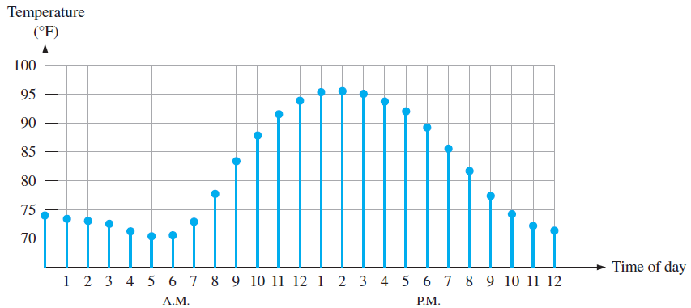
Digital and Analog Quantities
Most natural quantities that we see are analog and vary continuously. Analog systems can generally handle higher power than digital systems.
Digital systems can process, store, and transmit data more efficiently but can only assign discrete values to each point.

Slide 6
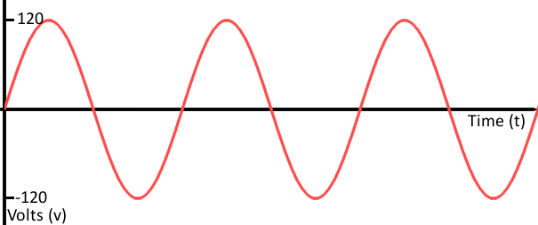
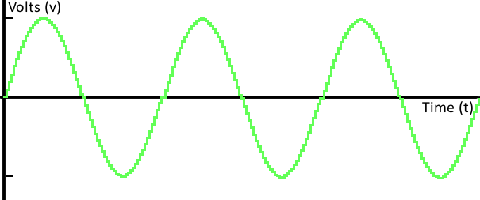
Digital and Analog Quantities
Analog | Digital
Has infinite possibilities | Has finite possibilities
Can take any value at any instant of time within the limit / the range specified | Has value only at discrete instance of time
Difficult to store and prone to errors due to leakage or noise | Easy to store and manipulate without much error
Difficult to measure accurately | Accuracy can be improved by adding more level of measurements
Example : FM radio | Example : HDMI for video and audio

Slide 7
Digital and Analog Quantities
Recently, many types of devices have been converted from analog to digital.
Examples:
In all of these digital devices, info is stored and transmitted in binary form (1s and 0s).
Analog | Digital
Record albums | CDs
VHS tapes | DVDs
Analog television | Digital TV

Slide 8
Digital and Analog Quantities
Many systems use a mix of analog and digital electronics to take advantage of each technology. A typical CD player accepts digital data from the CD drive and converts it to an analog signal for amplification.

Slide 9
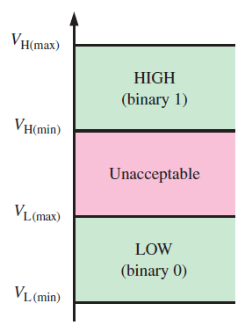
Binary Digits, Logic Levels, and Digital Waveforms
Digital electronics uses circuits that have two states, which are represented by two different voltage levels called HIGH and LOW. The voltages represent numbers in the binary system.
In binary, a single number is called a bit (for binary digit). A bit can have the value of either a 0 or a 1, depending on if the voltage is HIGH or LOW.
Logic level ranges
of voltage for a digital circuit.

Slide 10
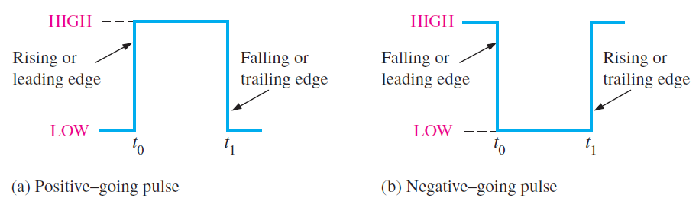
Binary Digits, Logic Levels, and Digital Waveforms
Digital waveforms change between the LOW and HIGH levels. A positive going pulse is one that goes from a normally LOW logic level to a HIGH level and then back again. Digital waveforms are made up of a series of pulses.
A pulse has two edges: a leading edge that occurs first at time t0 and a trailing edge that occurs last at time t1.
Ideal pulses.

Slide 11
Binary Digits, Logic Levels, and Digital Waveforms
Actual pulses are not ideal but are described by the rise time, fall time, amplitude, and other characteristics.
Nonideal pulse characteristics.

Slide 12


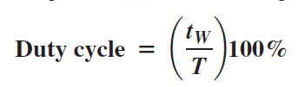
Binary Digits, Logic Levels, and Digital Waveforms
Periodic pulse waveforms are composed of pulses that repeats in a fixed interval called the period. The frequency is the rate it repeats and is measured in hertz.
The clock is a basic timing signal that is an example of a periodic wave.
Example
What is the period of a repetitive wave if f = 3.2 GHz?
Solution
313 ps

Slide 13
Binary Digits, Logic Levels, and Digital Waveforms
In addition to frequency and period, repetitive pulse waveforms are described by the amplitude (A), pulse width (t_{W}) and duty cycle. Duty cycle is the ratio of t_{W} to T.
Pulse width (t_{W})
Amplitude (A)
Period, T

Slide 14
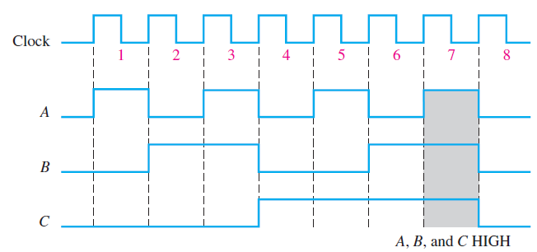
Binary Digits, Logic Levels, and Digital Waveforms
A timing diagram is a graph of digital waveforms showing the actual time relationship of two or more waveforms and how each waveform changes in relation to the others.
Example of a timing diagram.
A diagram like this can be observed directly on a logic analyzer.

Slide 15
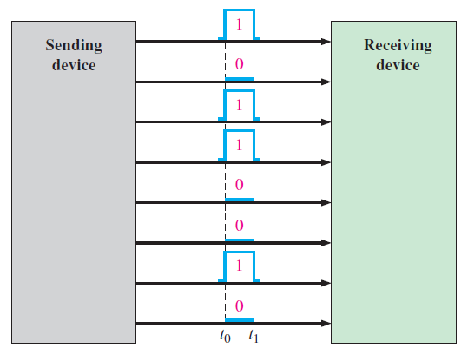
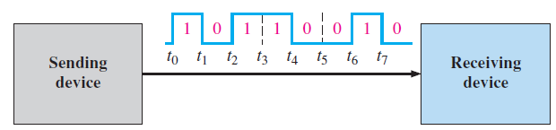
Binary Digits, Logic Levels, and Digital Waveforms
Data refers to groups of bits that convey some type of information. When bits are transferred in serial form from one point to another, they are sent one bit at a time along a single line When bits are transferred in parallel form, all the bits in a group are sent out on separate lines at the same time.
Serial transfer of 8 bits of binary data. Interval t₀ to t₁ is first.
Parallel transfer of 8 bits of binary data. The beginning time is t₀.

Slide 16
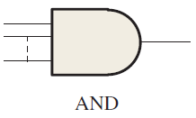
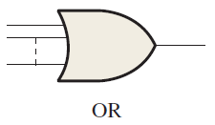
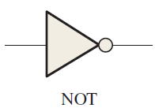
Basic Logic Functions
AND
True only if all input conditions are true.
OR
True only if one or more input conditions are true.
NOT
Indicates the opposite condition.

Slide 17
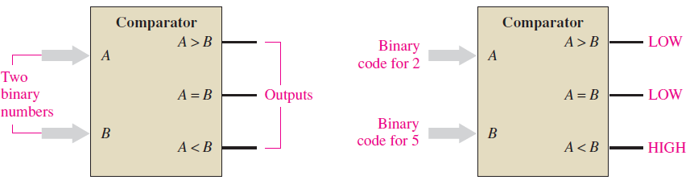
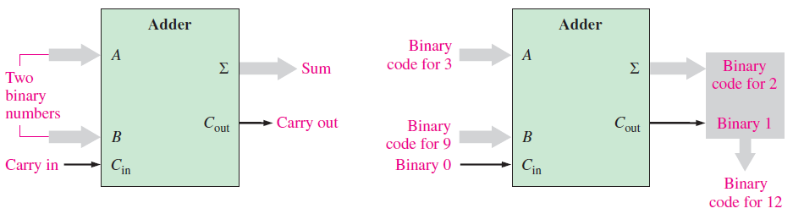
Basic Logic Functions
And, or, and not elements can be combined to form various logic functions. A few examples are:
The comparison function
Basic arithmetic functions

Slide 18
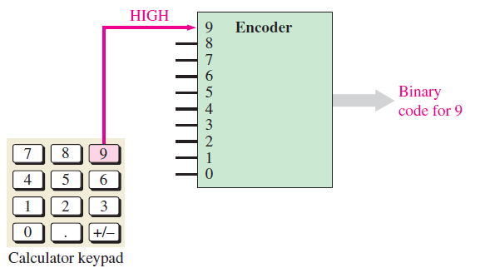
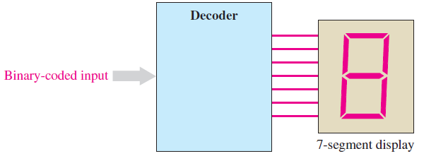
Basic Logic Functions
The encoding function
The decoding function

Slide 19
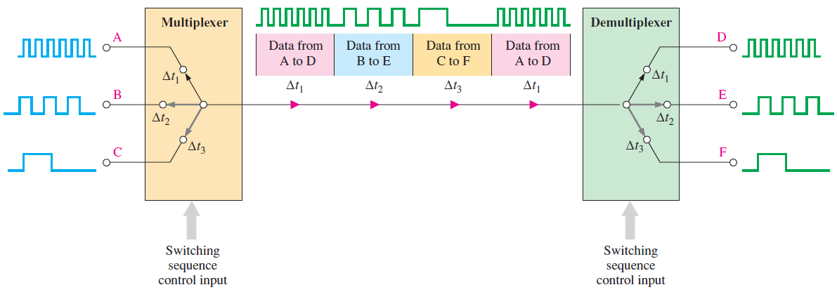
Basic Logic Functions
The data selection function
Two types of circuits that select data are the multiplexer and the demultiplexer.
The multiplexer is a logic circuit that switches digital data from several input lines onto a single output line in a specified time sequence.
The demultiplexer (demux) is a logic circuit that switches digital data from one input line to several output lines in a specified time sequence.

Slide 20
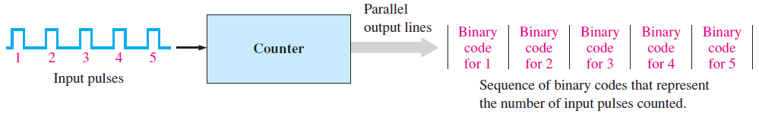
Basic Logic Functions
The counting function
There are many types of digital counters, but their basic purpose is to count events represented by changing levels or pulses.
To count, the counter must “remember” the present number so that it can go to the next proper number in sequence.
Therefore, storage capability is an important characteristic of all counters, and flip-flops are generally used to implement them.

Slide 21
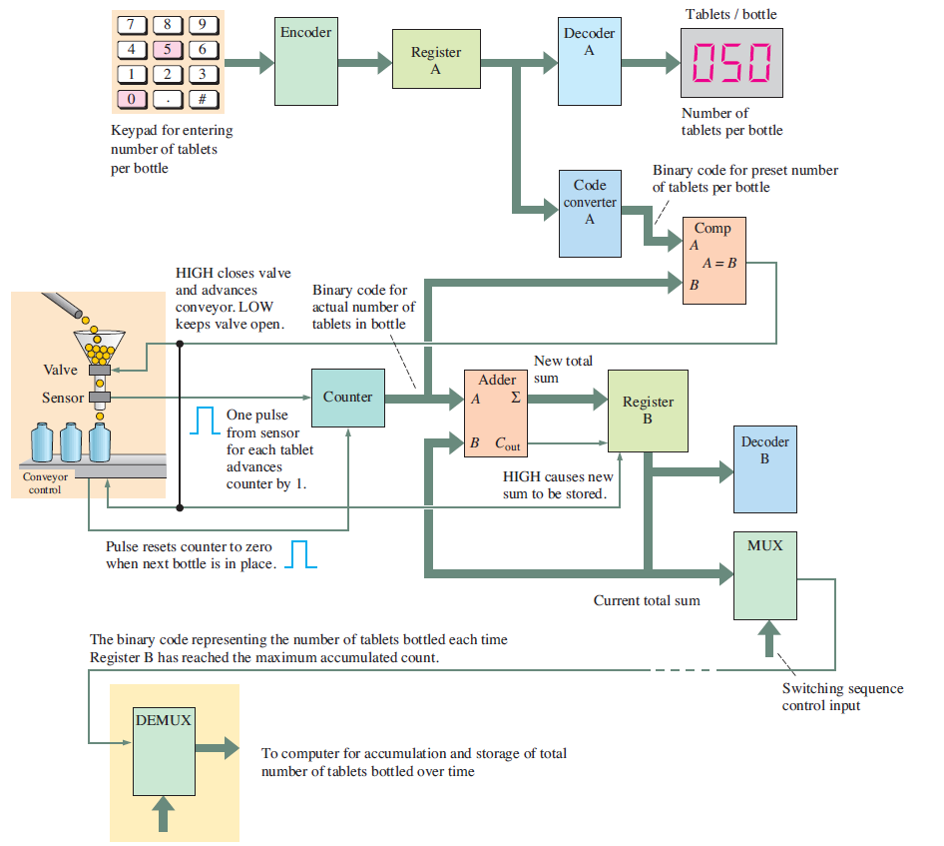
Basic Logic Functions
Process Control system

Slide 22
Exercise
Name two advantages of digital data as compared to analog data.
Form a single logical statement from the following information:
(a) The light is ON if SW1 is closed.
(b) The light is ON if SW2 is closed.
(c) The light is OFF if both SW1 and SW2 are open.
A pulse waveform with a frequency of 20 kHz is applied to the input of a counter. During 40 ms, how many pulses are counted?
Give some examples of the type of information that you look for when a system is reported to have failed.

Slide 23
References
Null, Linda (2024). "The essentials of computer organization and architecture". 6th edition. Jones & Bartlett Learning, Burlington, Massachusetts. ISBN: 9781284259438..
Thomas L. Floyd. (2014). “Digital Fundamentals”. 11th Edition. Prentice Hall. New Jersey. ISBN: 978-0132737968.
Basic Gates and Functions : http://www.ee.surrey.ac.uk/Projects/CAL/digital-logic/gatesfunc/index.html

